Slide 1
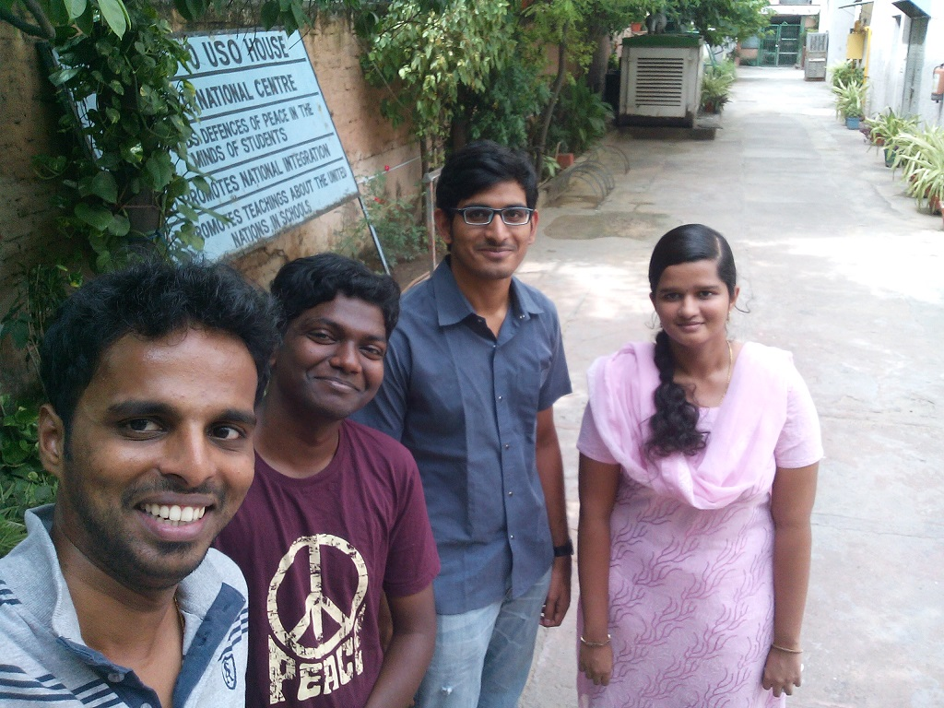
T
E
A
M
Innov-8-ers
Sai Meera
Syam gopal
Vasavi Krishna
Shodhan Shetty

Slide 2

THE IDEAS THAT JUST MISSED
Edible bottles for water, cool drinks
Automatic bottle crusher
E-waste management

Slide 3
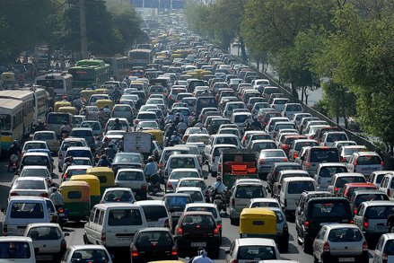
PROBLEM STATEMENT
The city needs efficient traffic management for better utilization of time, energy and other resources because people waste lot of time and fuel waiting in traffic leading to lot of problems.

Slide 4
Thinking Hats
Initiate discussion by providing the problem statement
Control flow of discussion
Make decisions to implement/discard suggestions
Provide data about companies, employees etc in Bangalore
Over 5.4 Million vehicles (3.7 2W, 1.1LMV) in Bangalore
Over 2.5 Million IT Professionals
Average Indian Travelling time: 90 mins/day

Slide 5

Thinking Hats…
Smar’t’ City (smart traffic city)
Traffic Volunteering
Car Pooling
Office timing flexibility
Digital signals
Strict Pedestrian laws - Over bridge
Planned public transport – Subsidized/free passes

Slide 6
Thinking Hats…
Growing economy needs tech parks, townships etc thereby facilitating growth
Cost efficient, networking in car pooling & t-smart city
Employees will reach on time and be more productive
Revenue for govt through greater usage of public transport
Saves time, fuel and effort

Slide 7
Thinking Hats…
Laws will not be approved easily
Requires support of everyone
Smar’t’ city requires extensive planning
Smar’t’ cities may not work for all companies
T-smart City will benefit everyone and bring in comfort
More time to spend with family as traffic time is reduced considerably

Slide 8
Thank You

Slide 9
T-SMART CITY
OFFICE COMPLEXES/
INDUSTRIES/
BUSINESS UNITS
COMMERCIAL COMPLEXES/
SHOPS/
HOSPITALS/
RECREATION/
SCHOOLS
ETC…
RESIDENTIAL AREA

